Slide 1
Infrastructure and Workflow for the Formal Evaluation of
Semantic Search Technologies
Stuart N. Wrigley¹, Raúl García-Castro² and Cassia Trojahn³
¹University of Sheffield, UK
²Universidad Politécnica de Madrid, Spain
³INRIA, France
Data infrastructurEs for Supporting Information Retrieval Evaluation:
DESIRE 2011 Workshop

Slide 2


SEALS Project
SEALS: Semantic Evaluation At Large Scale
EU FP7 funded Infrastructures project
June 2009 – June 2012.
Initial areas: ontology engineering, ontology storage and reasoning tools, ontology matching, semantic web service discovery, semantic search
Objectives:
  SEALS Platform.
    A lasting reference infrastructure.
    Evaluations executed on-demand on SEALS Platform.
  SEALS Evaluation Campaigns.
    Two public evaluation campaigns
  SEALS Community.

Slide 3
Key (non-technical) features
Infrastructure characteristics:
  Open (both in terms of use and development – Apache 2.0 license)
  Scalable (to users and data size – cluster-based)
  Extensible (new evals, new tool types, new metrics)
  Sustainable (beyond funded period)
  Independent (unbiased, trustworthy)
  Repeatable (eval results can be reproduced)
Core criteria:
  Interoperability
  Scalability
  Tool-specific measures (e.g., alignment precision, etc)

Slide 4




Evaluation dependencies
Tools
ER
Execution Request
Evaluation
Results
Test data
Evaluation descriptions

Slide 5
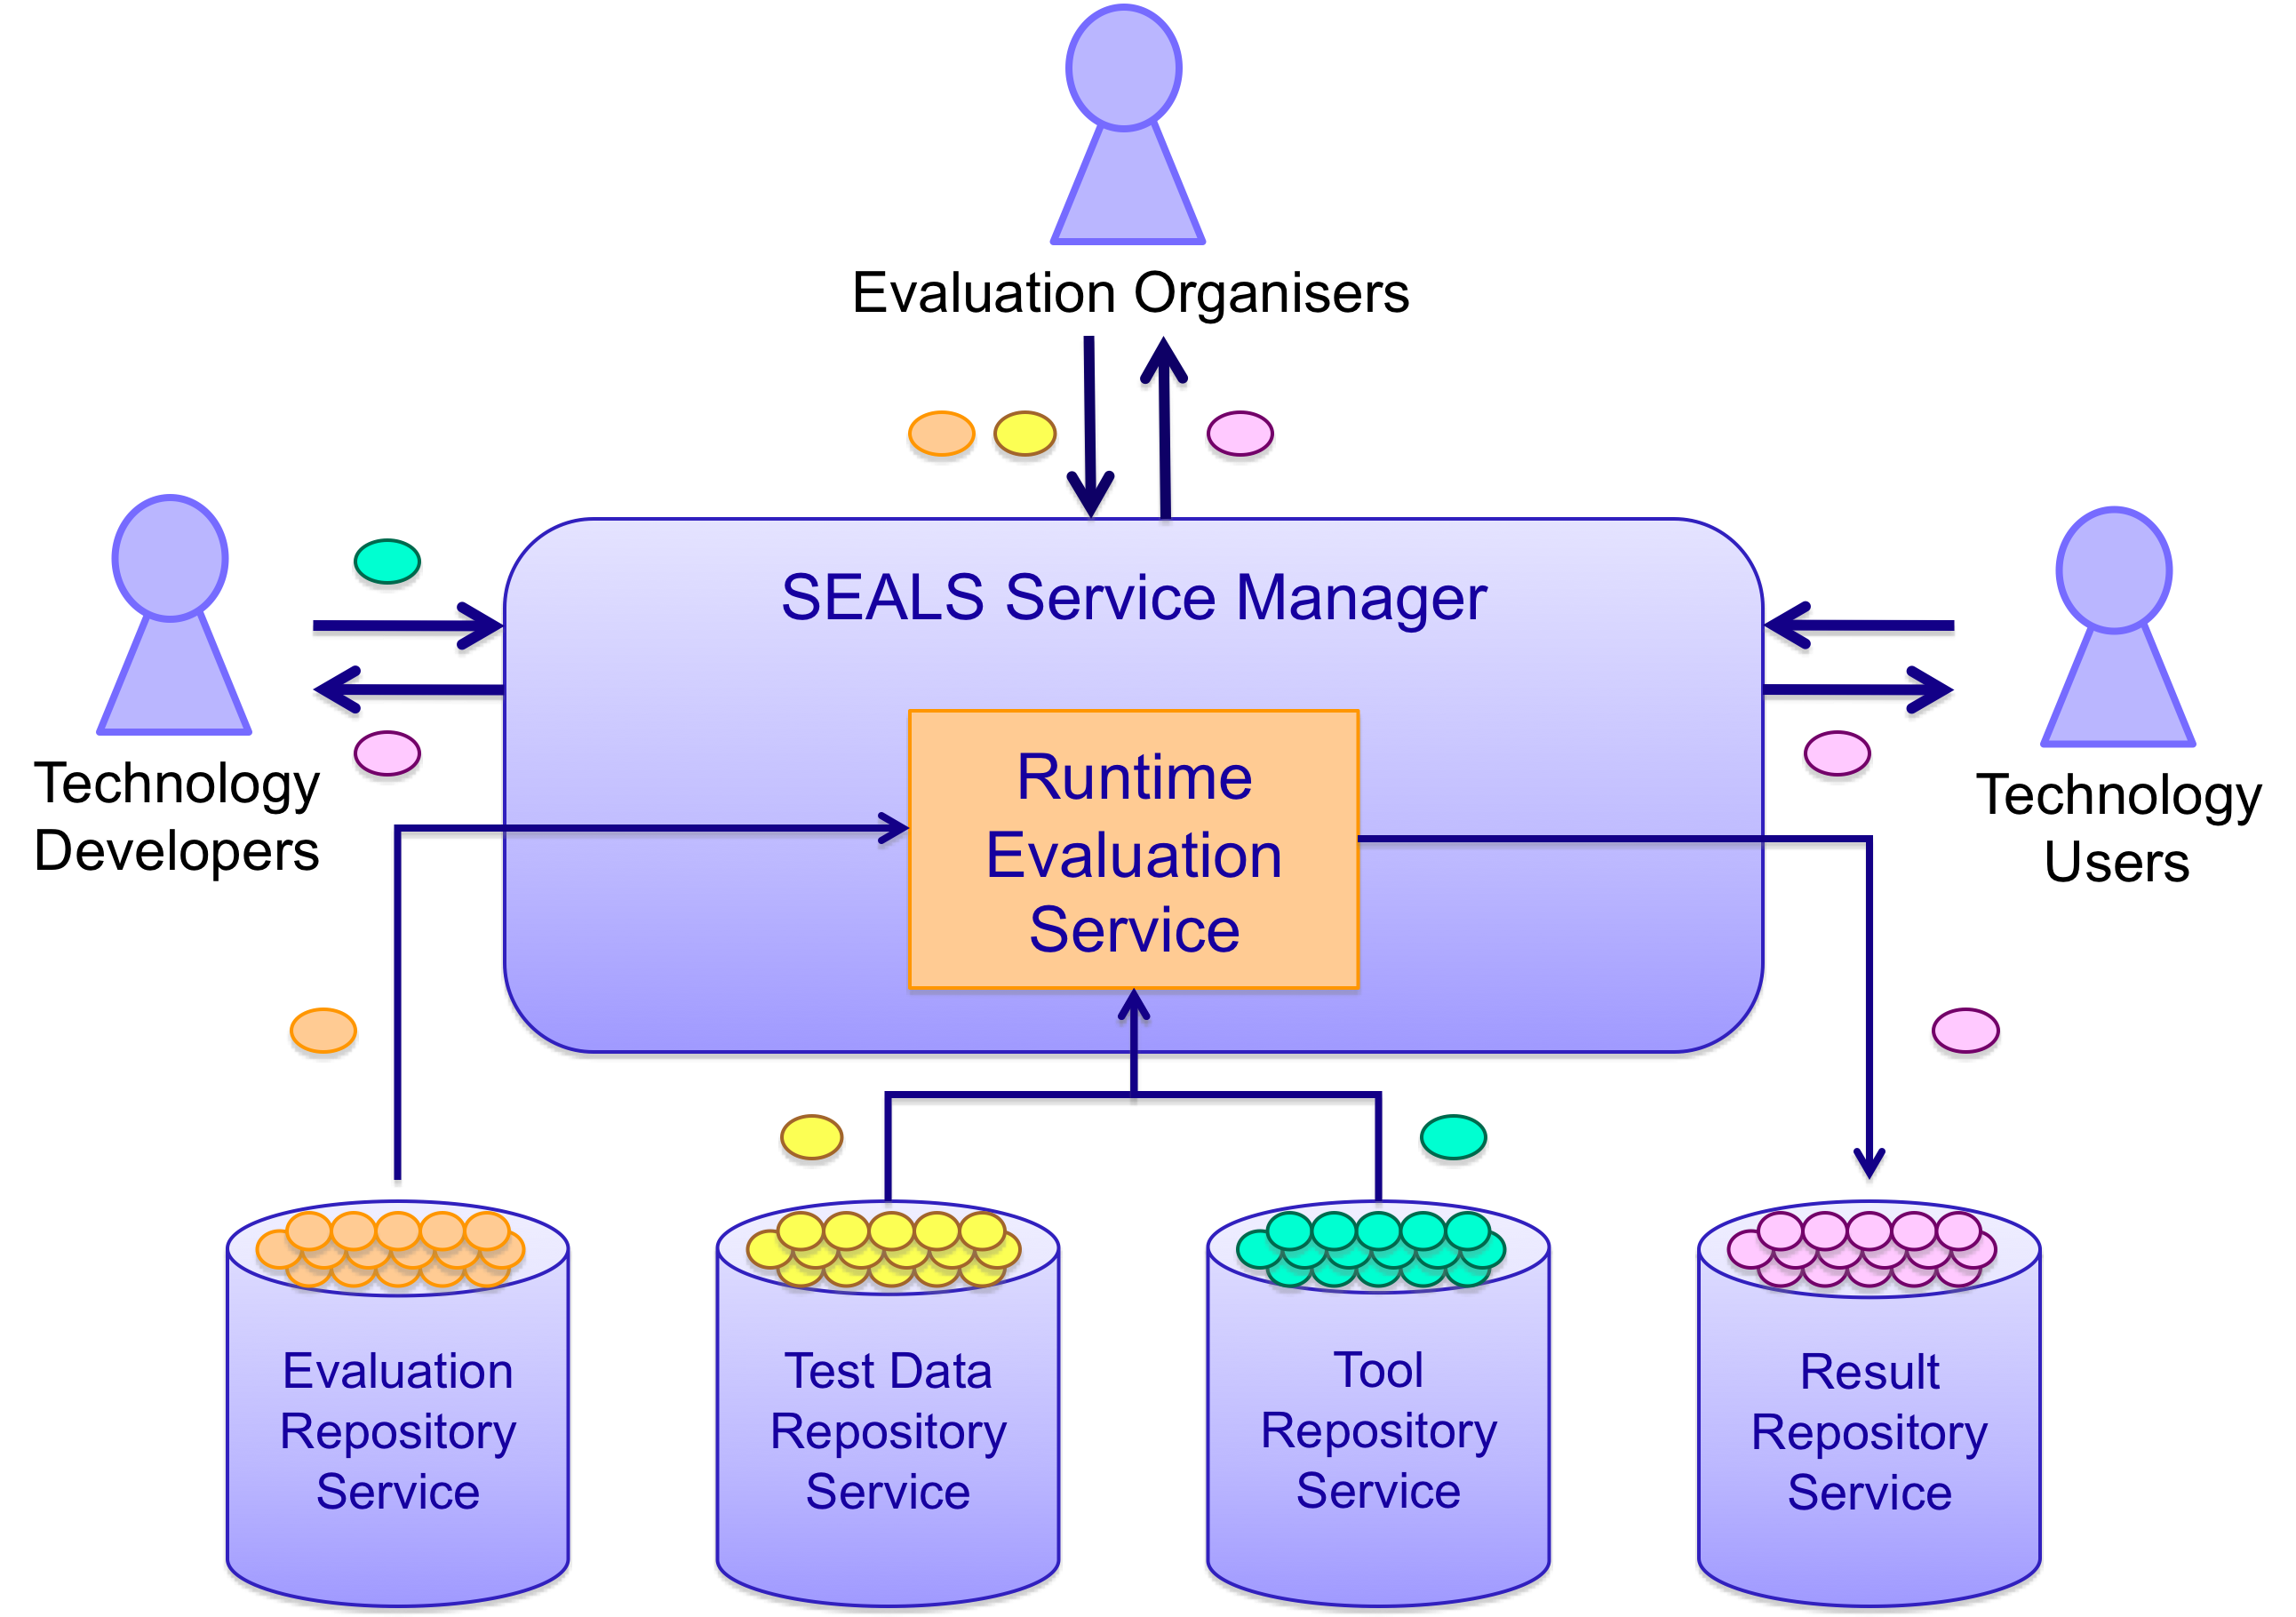
Platform architecture

Slide 6
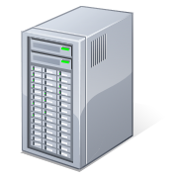


Evaluation overview
Infrastructure request
Tools deployment
Tools undeployment
Infrastructure release
Execution request
analysis
Execution environment preparation
Evaluation description execution
Execution environment clean-up
ER
Activity Execution
Test data stage-out
Test data stage-in
Results storage

Slide 7
Repositories

Slide 8
Repositories
External Interface
HTTP
Request
File
Restlet Resources
Internal Interface
Java objects
Test Data Repository
Tools
Repository
Results
Repository
Implementation
Implementation
Implementation
Storage
RDF
Triples
File
RDF
Repository
(Metadata)
File
Repository
(Artifacts)

Slide 9
Test Data Repository Service (TDRS)
Storage of, and access to:
  persistent test data sets (aka suites)
  test data generators
Suites are stored as ZIP files and accompanied by metadata.
Suites can be versioned.
ZIP-internal metadata allows structuring and repository-based iteration.
Entity
Data
Metadata
Data
Artifact
Artifact
Artifact
Item
Discovery
Exploitation

Slide 10
Results Repository Service (RRS)
Storage of, and access to, suites of:
  raw results
  interpretations
Suites stored as metadata and optional ZIP files.
Metadata allows structuring and linking to ensure backlinks:
  interpretation links to raw result dataItem
  raw result links to tool and test suite dataItem

Slide 11
Tools

Slide 12
Tool wrapping and storage
Tools are evaluated on within the Platform (ie, locally)
Tools must have bi-directional communication with Platform.
Each campaign (e.g., search) defines its own Java API specific to their tool type.
Participating tools create a tool ‘wrapper’ to implement API.
Also includes ‘setup’ and ‘tear down’ scripts and any 3rd party libraries / packages required.
Bundles stored in Tool Repository Service (TRS).
Tutorials on SEALS portal (http://www.seals-project.eu/).

Slide 13
Semantic Search API
Method | Functionality
boolean loadOntology( URL ontology, String ontologyName, String ontologyNamespace) | Load an ontology
void showGUI(boolean show) | Switch the GUI on or off
boolean executeQuery(String query) | Execute a query
boolean isResultSetReady() | Are query results ready?
URL getResults() | Retrieve the URL of the results file
boolean isUserInputComplete() | Has user hit ‘go’ (or equivalent)?
String getUserQuery() | Retrieve the query as entered by the user

Slide 14
Workflows

Slide 15
Evaluation overview (workflow)
Infrastructure request
Tools deployment
Tools undeployment
Infrastructure release
Execution request
analysis
Execution environment preparation
Evaluation description execution
Execution environment clean-up
ER
Activity Execution
Test data stage-out
Test data stage-in
Results storage

Slide 16
Workflow
Business Process Execution Language (BPEL)
  orchestrates manipulation of information using (only) web services interfaces.
All entities involved must be exposed as web services (TDRS, RRS, the tool wrapper, custom services) defined using WSDL interfaces.
‘Custom services’ allow out-of-band processing:
  computation of analyses
  data / metadata manipulation
  timestamping
  etc.
Workflow defined according to campaign requirements.
Stored in the Evaluation Repository Service (ERS).

Slide 17
Conceptual workflow for search

Slide 18
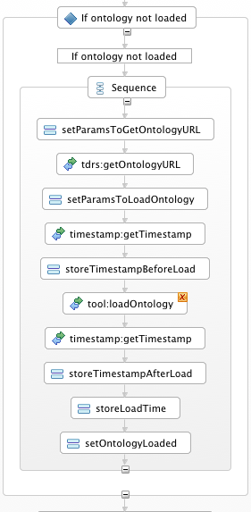
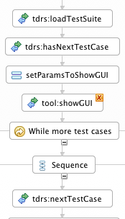
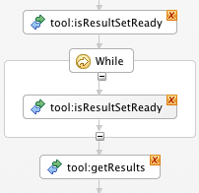
BPEL workflow snippets
S
Stored as XML

Slide 19
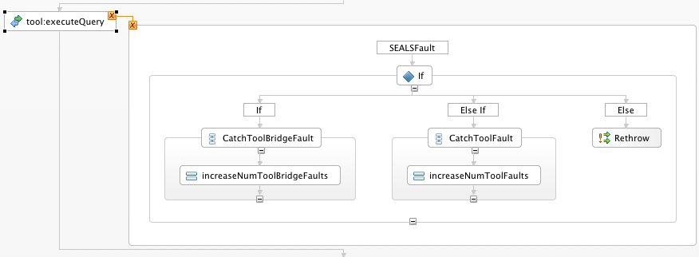
BPEL exception handling

Slide 20
Summary
SEALS Platform provides functionality to simplify and automate evaluations.
Powerful cluster-based compute.
Storage of test data, results and interpretations in perpetuity.
Workflows specified in industry-standard BPEL.
All for free!

Slide 21
Thank you for your attention!
http://www.seals-project.eu/

Slide 22
Links to resources
Evaluation campaigns
  http://www.seals-project.eu/seals-evaluation-campaigns/
Test suites
  Mooney (NL questions)
    http://seals.sti2.at/tdrs-web/testdata/persistent/Mooney+NL+Testsuite/2010/
  EvoOnt (SPARQL questions)
    http://seals.sti2.at/tdrs-web/testdata/persistent/EvoOnt+1K+SPARQL+Testsuite/2010/
    http://seals.sti2.at/tdrs-web/testdata/persistent/EvoOnt+10K+SPARQL+Testsuite/2010/
    http://seals.sti2.at/tdrs-web/testdata/persistent/EvoOnt+100K+SPARQL+Testsuite/2010/
    http://seals.sti2.at/tdrs-web/testdata/persistent/EvoOnt+1000K+SPARQL+Testsuite/2010/
    http://seals.sti2.at/tdrs-web/testdata/persistent/EvoOnt+10000K+SPARQL+Testsuite/2010/
  QALD
    http://seals.sti2.at/tdrs-web/testdata/persistent/QALD-MusicBrainz+SPARQL+Testsuite/2010/
Last year’s campaign outcomes
  http://www.seals-project.eu/seals-evaluation-campaigns/semantic-search-tools/results-2010

